Slide 1

Update and Protect
the Library’ Collection
Group:刘振伟、陈钟宇、张庆阳

Slide 2
https://www.ypppt.com/
目 录
PART 1
Problem in the
school library
CONTENT
PART 2
What we want
to achieve
PART 3
What to do
PART 4
Potential Challenge
PART 5
Conclusion

Slide 3
01
Problem in the
school library

Slide 4

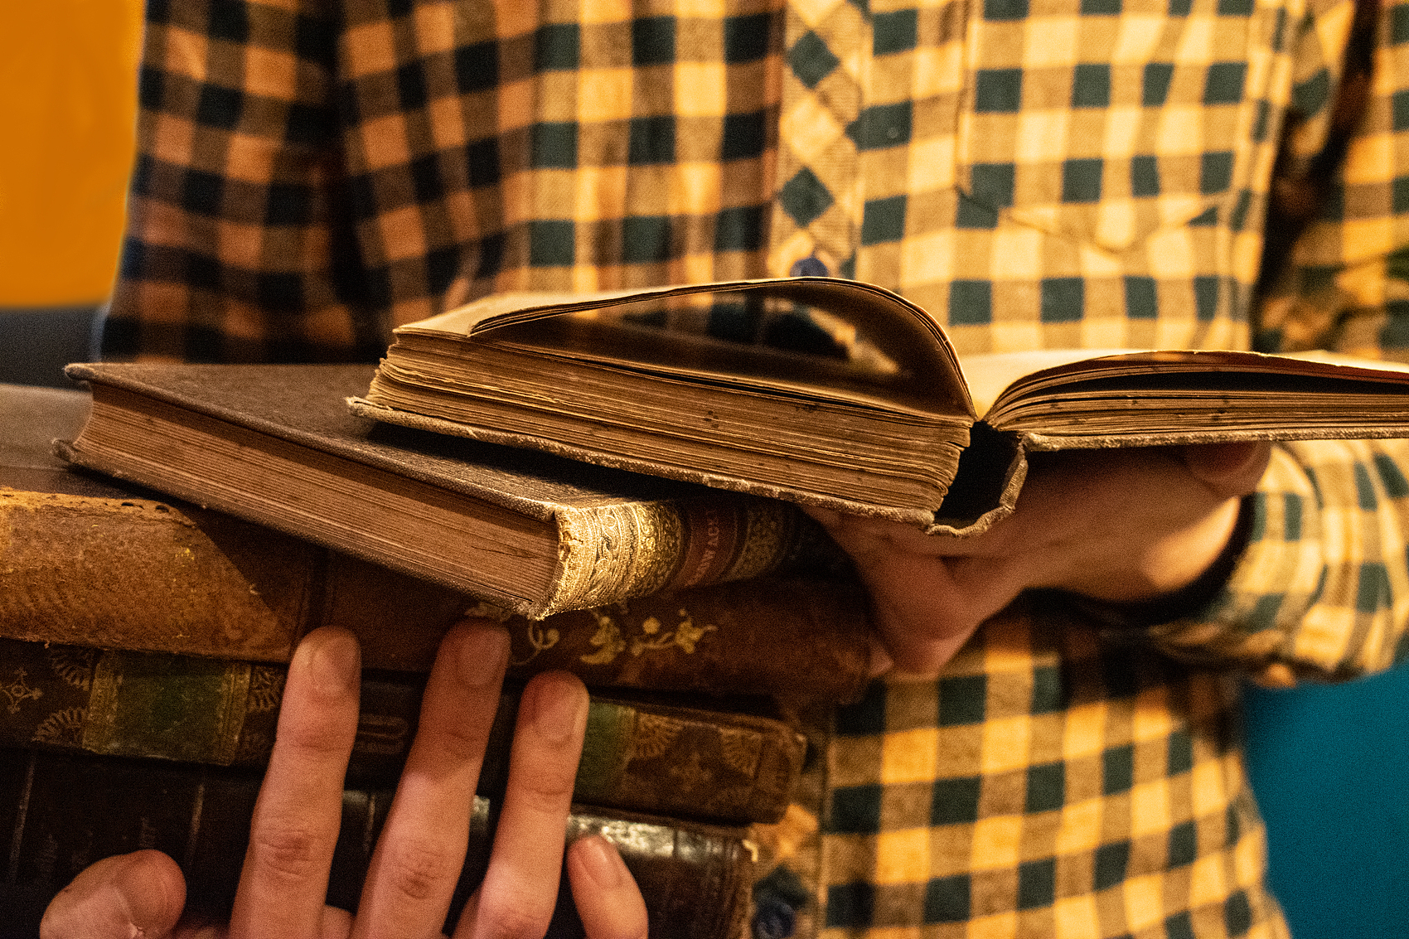
Problem
Current Situation
some books in the library are worn out.
a lack of newly published books.
Impact
Students cannot obtain a good reading experience.

Slide 5
02
What we want
to achieve

Slide 6
Goals
to protect the books
more choices
Standardize the book borrowing process
Enrich the library's collection
01
02
03
Replace worn-out books
better experience

Slide 7
03
What to do

Slide 8
Action : Books Donation Event
target audience:
students
timeline:
every two months
1
2
activity location
3
library hall
4
5
5
budget:
promotional posters、fliers、giveaways
organizers and volunteers & key partnerships:
NJU logistics support

Slide 9
04
Potential Challenges

Slide 10

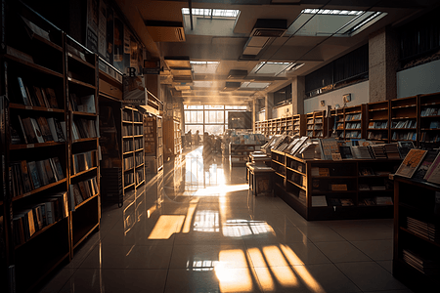
Potential chanllenges and possible solutions
chanllenge1:
chanllenge2:
Damage to books after lending
Low participation
Solution:
Solution:
Require a deposit or compensation
Promote through social media and incentives

Slide 11
05
Conclusion

Slide 12
Expectation
Rich and up-to-date library collections, well-preserved books.
Project’s Value
This project reaffirms library contribute to our academic life and we must pay attention to it.
Call for Support
Join the Book Donation Event.
Endorse and secure resources for renewal.

